Slide 1
Assignment
Just another design for you to enjoy! Make sure to snip both the XAML and Logic code before submission. Don’t forget the Output snip! Be creative and do a wonderful job.

Slide 2
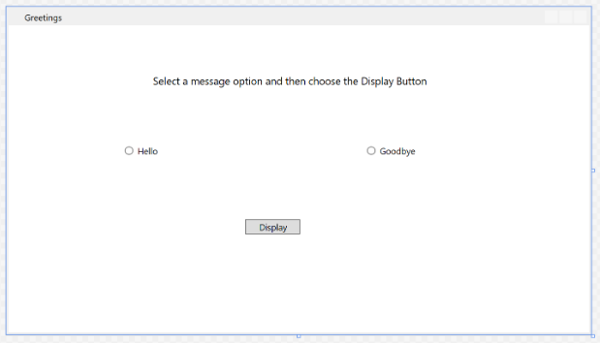
Use this window as a guide.

Slide 3
Quick Guidelines
Design though similar but a better window with two radio buttons, Hello and Goodbye. (Your colour choice and graphics should be appealing and User friendly)
Add code to the display button, such that when this application runs, a message box appears after a user chooses a radio button and then chooses the Display button.
One message box will appear for Hello, and another will appear for Goodbye. To create this behavior, you'll add code to the Button_Click event in Greetings.xaml.cs.

